Slide 1
7 Algorithm design and problem-solving
Inputs, processes, outputs and storage

Slide 2
Inputs, processes and outputs
INPUT
An electronic device that takes input…

Slide 3
Inputs, processes and outputs
INPUT
PROCESS
An electronic device that takes input, processes data…

Slide 4
Inputs, processes and outputs
INPUT
PROCESS
OUTPUT
An electronic device that takes input, processes data and delivers output.

Slide 5
Inputs, processes and outputs
INPUT
5
PROCESS
OUTPUT
An electronic device that takes input, processes data and delivers output.

Slide 6
Inputs, processes and outputs
INPUT
5
PROCESS
Multiply by 2
OUTPUT
An electronic device that takes input, processes data and delivers output.

Slide 7
Inputs, processes and outputs
INPUT
5
PROCESS
Multiply by 2
OUTPUT
10
An electronic device that takes input, processes data and delivers output.

Slide 8

Inputs, processes and outputs
INPUT
PROCESS
OUTPUT

Slide 9

Inputs, processes and outputs
INPUT
PROCESS
OUTPUT

Slide 10

Inputs, processes and outputs
INPUT
PROCESS
OUTPUT

Slide 11

Inputs, processes, outputs and storage
INPUT
PROCESS
OUTPUT
STORAGE

Slide 12

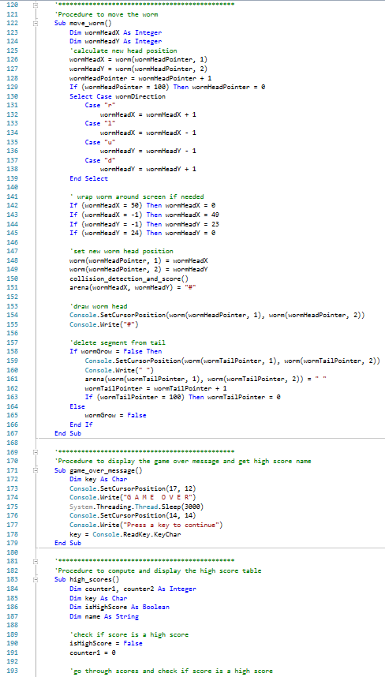


Inputs, processes, outputs and storage
When writing a computer program, we need to be able to identify the inputs, processes, outputs and storage requirements of the problem.
Under exam conditions, this will usually relate to a provided scenario.

Slide 13

Inputs, processes, outputs and storage
“Write a program to calculate the volume of a fish tank based on its dimensions, and report the result to the user.”
Input
Process
Output

Slide 14
Inputs, processes, outputs and storage
Depth
“Write a program to calculate the volume of a fish tank based on its dimensions, and report the result to the user.”
Input | Length: Real/float Height: Real/float Depth: Real/float
Process | Length x Height x Depth
Output | Volume: Real/float
Height
Length

Slide 15
Inputs, processes, outputs and storage
Depth
“Write a program to calculate the volume of a fish tank based on its dimensions, report the result to the user and write the results to a text file.”
Input | Length: Real/float Height: Real/float Depth: Real/float
Process | Length x Height x Depth
Output | Volume: Real/float
Storage | Volume: Real/float
Height
Length

Slide 16

Inputs, processes, outputs and storage
“Write a program that asks the user for the number of students in their class and then prompts the user to enter each student’s test score within a range of 0–100. The program should then output the highest, lowest and average score to the user as well as saving there highest score to a file for future retrieval.”
Input
Process
Output
Storage

Slide 17
Inputs, processes, outputs and storage
“Write a program that asks the user for the number of students in their class and then prompts the user to enter each student’s test score within a range of 0–100. The program should then output the highest, lowest and average score to the user as well as saving there highest score to a file for future retrieval.”
Input | NumOfStudents: Integer CurrentScore: Integer
Process | TotalScore = TotalScore + CurrentScore AverageScore = TotalScore / NumOfStudents Store the list of scores in an array: Loop through and return the lowest score Loop through and return the highest score
Output | LowScore: Integer HighScore: Integer AverageScore: Real/float
Storage | HighScore: Integer

Slide 18

Inputs, processes and outputs
When tackling a problem, you need to consider any inputs, processes and outputs.
Inputs
Anything that needs to be supplied to the program so it can meet its goals – often supplied by the user.
Consider an appropriate variable name and data type for inputs.
Processes
Calculations that need to be performed while the program is running.
Consider whether any data need to change format or data type.
Outputs
Consider what your program needs to output to the user.
Consider what form outputs should take.
Consider an appropriate variable name and data type for outputs.
Storage
Consider any data that needs to be stored in files on an appropriate medium for use or retrieval in the future.

Slide 19


